Slide 1
Session 5
Strings

Slide 2
String: A group of characters strung together into a word,sentence, line or even paragraph is a string
“Hi” “Hi There” “Yo Man!! Oppa Gangnam Style”
Strings are amongst the most popular types in Python. We can create them simply by enclosing characters in quotes. Python treats single quotes the same as double quotes. Creating strings is as simple as assigning a value to a variable.
For example:
var1 = 'Hello World!‘
var2 = "Python Programming“
>>>word = 'word'
>>>sentence = "This is a sentence."
>>>paragraph = “““This is a \
paragraph \
across \
multiple lines.”””
>>> type("Hello World")
<class 'str'>

Slide 3
Python Strings (Cntd..)
Try and Learn:
Type out the code, observe the output and lets try to understand the logic
var1 = 'Hello World!'
var2 = "Python Programming"
print ("var1[0]: ", var1[0])
print ("var2[1:5]: ", var2[1:5])
Lets try a few more, lets bring it on!!
print("Hello Students"*2)
var1 =“Python Programming“
print(var1[-5:-1]+'Abdracadabra')

Slide 4
Python Strings – Indexing & Slicing
STRING INDEXING & SLICING
Remember arrays? A string is an array of characters.
Just like an array, you do have indexes for strings.
Python provides special tools to create substrings out of strings, it is called slicing.
Let’s do and learn Slicing, we have already seen a few scenarios on the last slide.
>>>str = 'Hello World!'
>>>str # Prints complete string
>>>str[0] # Prints first character of the string
>>>str[2:5] # Prints characters starting from 3rd(Included) to 5th(excluded)
>>>str[2:] # Prints string starting from 3rd character
>>> str[::-1] # Prints the string in reverse order, step size of -1.
>>>str[-1] # Prints the last item from the end
>>>str * 2 # Prints string two times
>>>str + "TEST" # Prints concatenated string

Slide 5
Python Strings – Indexing & Slicing
STRING INDEXING & SLICING
Remember arrays? A string is an array of characters.
Just like an array, you do have indexes for strings.
Python provides special tools to create substrings out of strings, it is called slicing.
Let’s do and learn Slicing, we have already seen a few scenarios on the last slide.
>>>str = 'Hello World!'
>>>str # Prints complete string
>>>str[0] # Prints first character of the string
>>>str[2:5] # Prints characters starting from 3rd(Included) to 5th(excluded)
>>>str[2:] # Prints string starting from 3rd character
>>> str[::-1] # Prints the string in reverse order, step size of -1.
>>>str[-1] # Prints the last item from the end
>>>str * 2 # Prints string two times
>>>str + "TEST" # Prints concatenated string

Slide 6
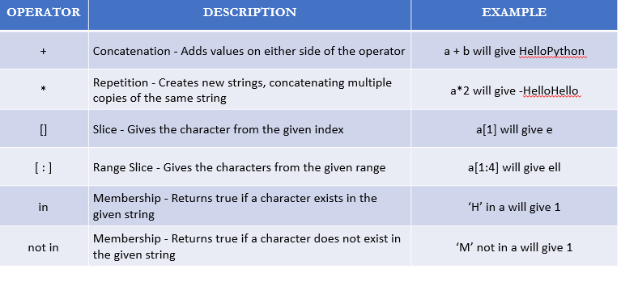
STRING OPERATIONS

Slide 7
STRING METHODS
STRINGS are classes.They come inbuilt with lots of useful methods.Lots of string editing stuff becomes easy to carry out because of these inbuilt methods.So here are a few important string methods .
>>>sTr = ‘Python’ #Len : Calculate the length of a string
>> len(sTr)
6

Slide 8
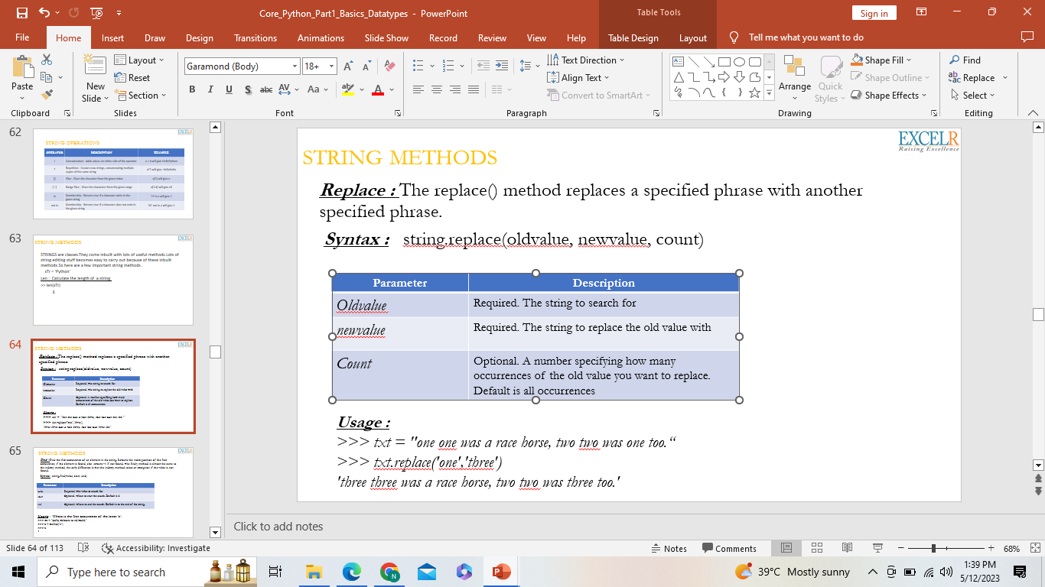
STRING METHODS
Replace : The replace() method replaces a specified phrase with another specified phrase.
Syntax : string.replace(oldvalue, newvalue, count)
Usage :
>>> txt = "one one was a race horse, two two was one too.“
>>> txt.replace('one','three')
'three three was a race horse, two two was three too.'

Slide 9
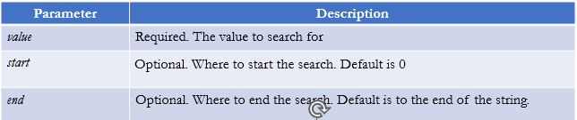
STRING METHODS Find : Find the first occurrence of an element in the string. Returns the index position of the first occurrence, if the element is found, else returns -1 if not found. The find() method is almost the same as the index() method, the only difference is that the index() method raises an exception if the value is not found. Syntax : string.find(value, start, end)
Usage : Where is the first occurrence of the letter ‘e’.
>>> txt = "Hello, welcome to my world."
>>> x = txt.find("e")
x = txt.find("e",2)
>>> x
1

Slide 10
Contd…..
Isalnum(): Check if all the characters in the text is alphanumeric. The isalnum() method returns True if all the characters are alphanumeric, meaning alphabet letter (a-z) and numbers (0-9).
Example of characters that are not alphanumeric: (space)!#%&? etc.
Syntax : string.isalnum()
Parameters : No parameters.
Usage :
>>> txt = "Company 12"
>>> x = txt.isalnum()
>>> x
False
>>> txt = "Company12"
>>> x = txt.isalnum()
>>> x
True

Slide 11
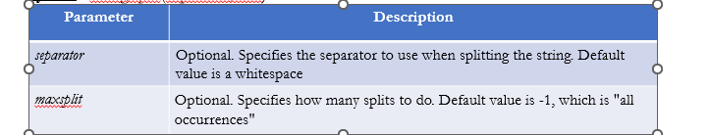
STRING METHODS Split : Split a string into a list where each word is a list item. You can specify the separator, default separator is any whitespace. Note : When maxsplit is specified, the list will contain the specified number of elements plus one. Syntax : string.split(separator,max)
Usage :
>>> txt = "hello, my name is Peter, I am 26 years old"
>>> x = txt.split(", ")
>>> x
['hello', 'my name is Peter', 'I am 26 years old']
>>> x = txt.split(", ",maxsplit = 1)
>>> x
['hello', 'my name is Peter, I am 26 years old']

Slide 12
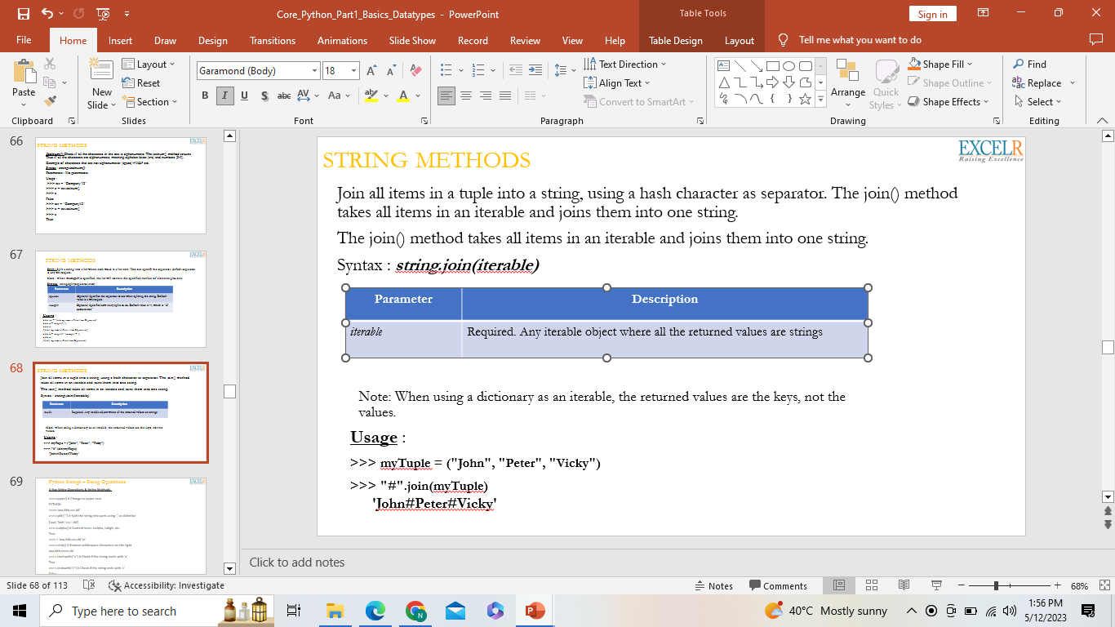
STRING METHODS Join all items in a tuple into a string, using a hash character as separator. The join() method takes all items in an iterable and joins them into one string. The join() method takes all items in an iterable and joins them into one string. Syntax : string.join(iterable)
Note: When using a dictionary as an iterable, the returned values are the keys, not the values.
Usage :
>>> myTuple = ("John", "Peter", "Vicky")
>>> "#".join(myTuple)
'John#Peter#Vicky'

Slide 13
Python Strings – String Operations
A few String Operations & String Methods
>>>s.upper() # Change to upper case
PYTHON
>>>s='aaa,bbb,ccc,dd’
>>>s.split(“,") # Split the string into parts using ‘,’ as delimiter
['aaa','bbb','ccc','dd’]
>>>s.isalpha() # Content tests: isalpha, isdigit, etc.
True
>>>s = ‘aaa,bbb,ccc,dd \n‘
>>>s.rstrip() # Remove whitespace characters on the right
aaa,bbb,ccccc,dd
txt = " banana " x = txt.lstrip() print("of all fruits", x, "is my favorite")
>>> s.startswith(“a") # Check if the string starts with ‘a’
True
>>> s.endswith(“c") # Check if the string ends with ‘c’
False

Slide 14
Python String center() Method
1) txt = "banana"
x = txt.center(80)
print(x)
2) txt = "banana"
x = txt.center(20, "O")
print(x)
Output :OOOOOOObananaOOOOOOO

Slide 15
Python String count() Method
ExampleGet your own Python Server
Return the number of times the value "apple" appears in the string:
txt = "I love apples, apple are my favorite fruit" x = txt.count("apple") print(x)
Search from position 10 to 24:
txt = "I love apples, apple are my favorite fruit" x = txt.count("apple", 10, 24) print(x)
MOre string slicing :https://www.geeksforgeeks.org/string-slicing-in-python/

Slide 16
Python String count() Method: Decode() is a method specified in Strings in Python 2. This method is used to convert from one encoding scheme, in which argument string is encoded to the desired encoding scheme. This works opposite to the encode. It accepts the encoding of the encoding string to decode it and returns the original string.
Syntax : decode(encoding, error) Parameters : encoding : Specifies the encoding on the basis of which decoding has to be performed. error : Decides how to handle the errors if they occur, e.g ‘strict’ raises Unicode error in case of exception and ‘ignore’ ignores the errors occurred. Returns : Returns the original string from the encoded string.
https://blog.hubspot.com/website/what-is-utf-8
# initializing string
str = "HelloIndia!"
# encoding string
str_enc = str.encode(encoding='utf8')
# printing the encoded string
print ("The encoded string in base64 format is : ",)
print (str_enc )
# printing the original decoded string
print ("The decoded string is : ",)
print (str_enc.decode('utf8', 'strict'))
Output: The encoded string in base64 format is : Z2Vla3Nmb3JnZWVrcw
The decoded string is : geeksforgeeks

Slide 17
Homework
Write a python program to get a word as input and access and display each letter of the word in a new line.
Write a program to create a mirror image of the given string. For example, “wel” = “lew“.

Slide 18
Python Strings – Raw Strings & String Formating operators
Raw Strings
A “raw” string will not convert \n sequences to newlines. A raw string precedes with ‘r’
>>> print('C:\some\name')
C:\some
ame
>>> print(r'C:\some\name‘)
C:\some\name
String Formatting Operators
One of Python's coolest features is the string format operator %. This operator is unique to strings and makes up for the pack of having functions from C's printf() family. Following is a simple example −
>>print ("My name is %s and weight is %d kg!" % ('Zara', 21))
Can you check what happens when you print the details?
Strings are immutable .Strings are read only

Slide 19
Python Strings – Triple Quotes
Triple Quotes
Python's triple quotes comes to the rescue by allowing strings to span multiple lines, including verbatim NEWLINEs, TABs, and any other special characters.
The syntax for triple quotes consists of three consecutive single or doublequotes.
para_str = """this is a long string that is made up of
several lines and non-printable characters such as
TAB ( \t ) and they will show up that way when displayed.
NEWLINEs within the string, whether explicitly given like
this within the brackets [ \n ], or just a NEWLINE within
the variable assignment will also show up.
""“
print(para_str)
When the above code is executed, it produces the following result. Note how every single special character has been converted to its printed form, right down to the last NEWLINE at the end of the string between the "up." and closing triple quotes. Also note that NEWLINEs occur either with an explicit carriage return at the end of a line or its escape code (\n) −

Slide 20
Python Strings – Escape Characters
\n
\t

